Slide 1
Band Bucks Mark Hawley
Bachelor of Business Administration,
Accounting and Information Technology

Slide 2

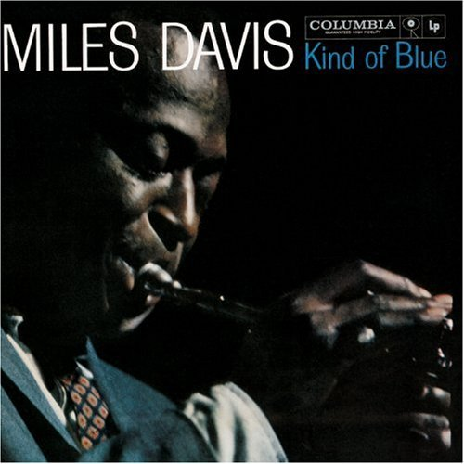

Background
Notes:
Music is love and there ain’t nothin’ real but love – Erykah Badu

Slide 3

Problem
Band = Business
Average Band Lifespan is 1 year
Why do most break up?
Musicians are not accountants
Journal Entries? Statements?
Focused on the music
Easy to lose track of things

Slide 4

Possible Solutions
By hand
Each notebook accessible at 1 location
Easy to lose
Inefficient, especially when consolidating data
Professional Accounting Software
Expensive
Complex
Out of scope for new bands

Slide 5



Band Bucks Application
Online application
Multiple user access across multiple locations
Easy and accessible for musicians
Simplified band accounting:
Equipment/Merchandise (Assets)
Debt (Liabilities)
Cash (Income = Equity)
Produce basic reports

Slide 6
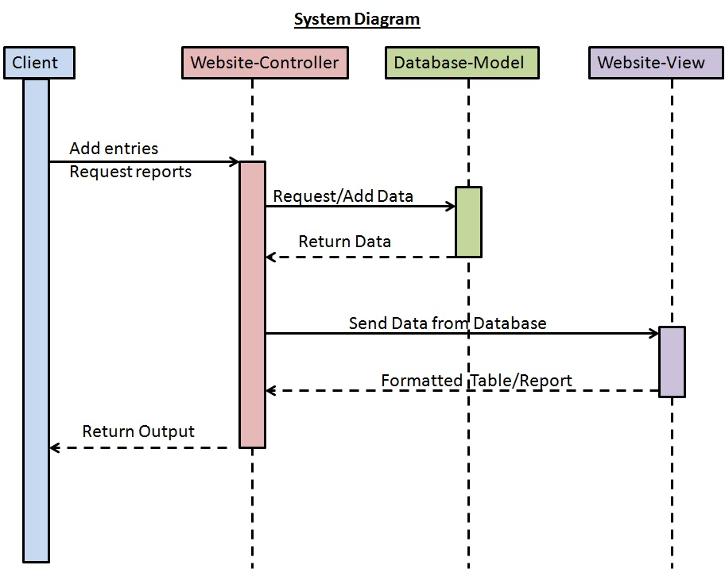

Slide 7
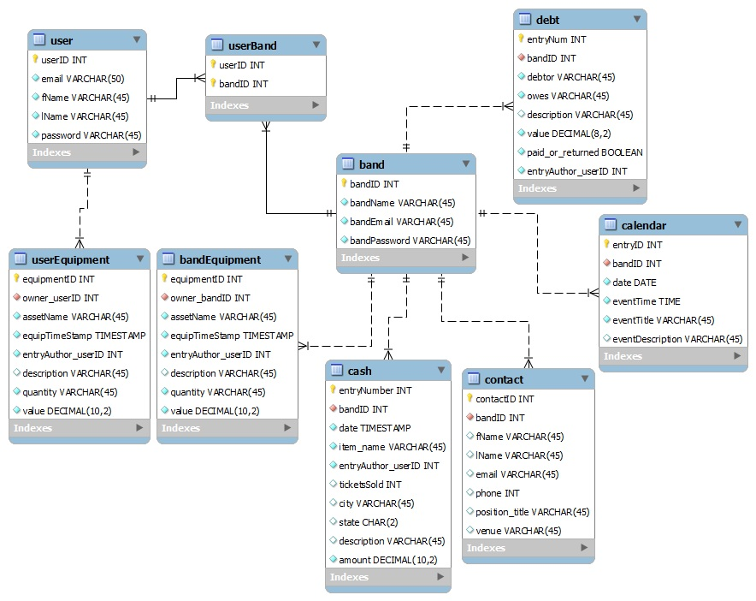

Slide 8
Results

Slide 9
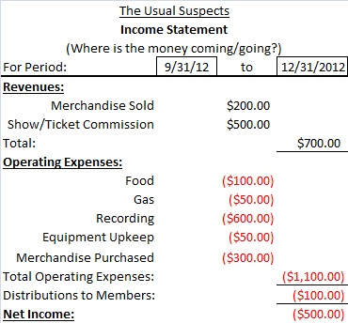
Future Work - Phase I
Band Selection List
Drop Down Entry Options
Form Validation
Running Total – Cash
Period Specific Reports:
Attendance Data
Income Statement
Debt
Equipment and Merchandise

Slide 10
Future Work - Phase II, etc.
Tutorial/FAQ/Tips
Calendar
Contacts
Band Notes/Memos
Tables searchable and sortable by column
Additional reports and data possibilities
iPhone/Android Accessible

Slide 11
Conclusion
Accounting program
Free
Easy to use
Jump start new bands
Understand/simplify the business side
Artists focus on their music

Slide 12
Questions?

